Slide 1
Cortana Intelligence Suite
Transform data into intelligent action

Slide 2
Azure PPE Technical Training
Module 1 – Introducing Cortana Intelligence Suite | Day 1
Module 2 – Information Management
Module 3 – Big Data Stores | Day 2
Module 4 – Machine Learning and Analytics Part 1
Module 5 – Machine Learning and Analytics Part 2 | Day 3
Module 6 – Cognitive Services
Module 7 – Power BI and Power BI Embedded | Day 4
Audience: Architects, Data Scientists and Developers

Slide 3
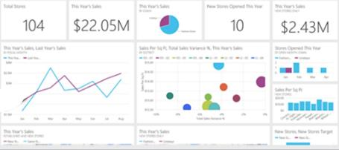
Keep a pulse on your business with live, interactive dashboards
Stream Analytics
Event Hubs
Power BI
Machine Learning
Storage
Power BI
Dashboards & Visualizations
SQL database
Power BI
HDInsight
Power BI
Analytics for everyone, even non-data experts
Your whole business on one dashboard
Create stunning, interactive reports
Drive consistent analysis across your organization
Embed visuals in your applications
Get real-time alerts when things change

Slide 4
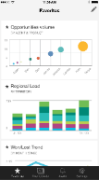
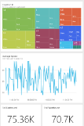
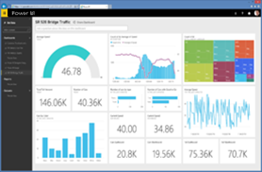
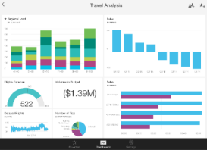
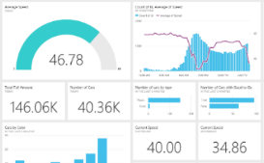

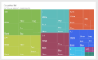


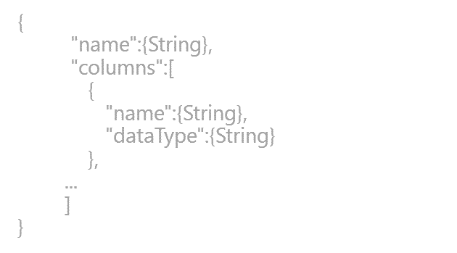
Power BI overview
SaaS solutions
E.g. Marketo, Salesforce, GitHub, Google analytics
Content packs
Natural language query
Sharing & collaboration
On-premises data
E.g. Analysis Services
Live dashboards
Organizational content packs Corporate data sources, or external data services
Visualizations
Azure services
E.g. Azure SQL, Stream Analytics
Excel files
Workbook data and data models
Reports
01001
10101
Power BI Desktop files
Related data from files, databases, Azure, and other sources
Datasets
0110001
00010110
Data refresh
Power BI Desktop
Power BI REST API
Prepare
Explore
Report
Share

Slide 5
Power BI overview
No matter what industry, or what role, Power BI is relevant
Business user
Import data from SaaS sources, and work with dashboards and reports
Business analyst
Import, reshape, integrate and model data
Create compelling reports and visualizations
Create content packs to share insights
BI professional
Connect to live Azure data services
Connect to on-premises Analysis Services databases
Empower colleagues to create their own reports
Developer
Integrate applications with Power BI
Create real-time dashboards
Develop custom visuals

Slide 6
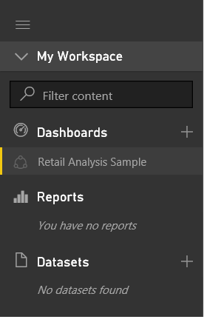
Introducing the Power BI online service
Continued
Users typically work with Power BI “building blocks”:
Datasets
Reports
Dashboards
Use the Navigation Pane to create, or select items of interest
Note: Creating and managing datasets will be covered in the next module

Slide 7
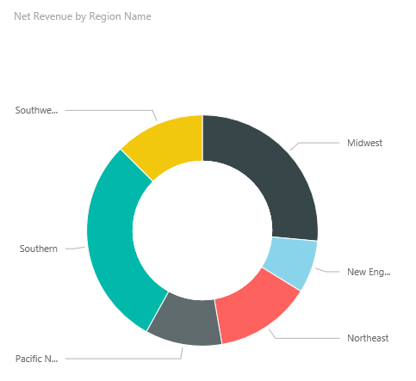
Creating and exploring reports
Creating reports
Use reports to layout visualizations across one or more pages
Rich, interactive reports can be created, updated and explored in the web browser experience
A report is based on a single dataset
Reports consist of one or more pages
Each page can be named, and consists of visualizations and shapes

Slide 8
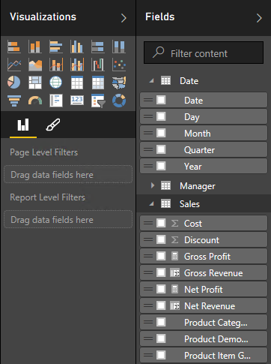
Creating and exploring reports
Creating reports
Dataset fields are used to layout a visualization
Visualization type and format can be adjusted to suit
Filtering can be applied at report, page or visualization level
Sorting can be set at visualization level

Slide 9
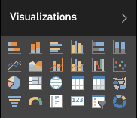
Creating and exploring reports
Creating reports: Visualization types
Choose from numerous modern visualization types:
Filter data:
Slicer
Display numeric values:
Card, Multi Row Card, Table, Matrix
Graphically visualize data:
Bar, Column, Line, Combo, Scatter, Waterfall, Pie, Donut, Funnel, Treemap, Gauge
Spatially visualize data:
Map, Filled map
Import custom visuals
Tip: Hover the cursor of each icon to reveal a tooltip description of the visualization type
Custom visuals are covered later in this training course

Slide 10
Creating and exploring reports
Exploring reports
Reports are either in Reading View or Editing View
In both views, report pages can be opened in Full Screen Mode, or individual visualizations can be popped out/in to see them zoomed in/out
In Reading View:
Users cannot change the report definition
Users can interact by changing filters or sorting
Users can highlight values in one visualization to filter other page visualizations
Shared reports can only be opened in Reading View
In Editing View:
Users can interact, as in Reading View
Users can also update the report (add/remove/reorder pages or visualizations)

Slide 11
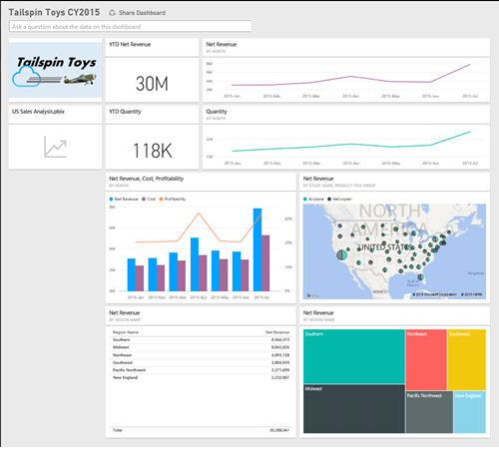
Assembling dashboards
Dashboards display tiles in a single canvas
A tile is sourced by “pinning” either a report, report visualization, or a Q&A response
A dashboard can be based on one or more datasets
Tiles can be resized and repositioned, and their titles/subtitles can be updated
Tiles can be sized to 1-5 units wide/high

Slide 12
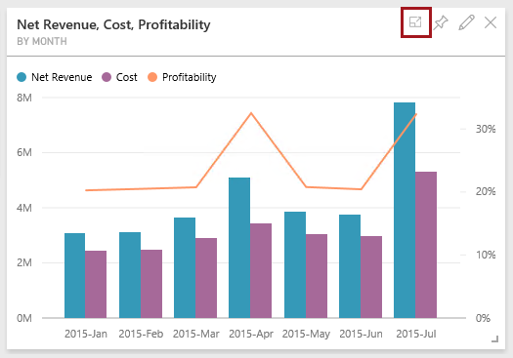
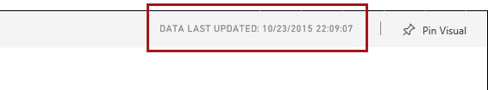
Assembling dashboards
Continued
Tiles can be opened in In-Focus Mode, filling the dashboard space
The data last updated date is displayed
Not available for tiles sourced from Q&A questions
Data can also be exported

Slide 13
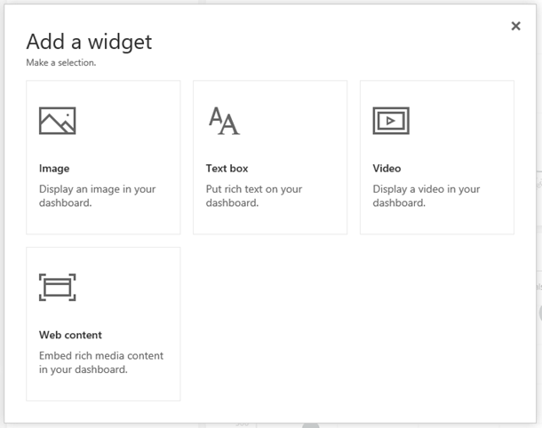
Assembling dashboards
Continued
Additionally, widgets can be added to a dashboard, using
Images
Text boxes
Videos
Web content

Slide 14
Assembling dashboards
Continued
Dashboards enable interactivity
By default, clicking on a tile will drill through to its source
However, a custom link (URL) can be set to override this default behaviour
Dashboard tiles can reflect live, real-time data
For non real-time datasets, tile thumbnails are automatically cached every 15 minutes
Dashboards can be displayed in Full Screen Mode
Additionally, all tiles can be displayed by using Fit to Screen
Note: Live dashboards can be achieved with Azure Stream Analytics integration or the Power BI REST API. Both topics are covered later in this course.

Slide 15
Exploring with Q&A
In the dashboard canvas, use Q&A to ask natural language questions
The dashboard must contain at least one tile to connect to a dataset, and
Only cloud-based cached datasets are supported
Q&A helps formulate an appropriate question
Q&A will format your question with suggestions, auto-complete, and even spelling corrections
Featured questions can be added to datasets
Only English questions are supported

Slide 16
Exploring with Q&A
Continued
Begin by asking “Show…”
For example:
Show <table>
Show <aggregate function><numeric column>
Show <measure> by <column>
Show <column> where <column> is before <date value>
Show <measure> where <column> is before <date value> sorted by <measure>
Show <measure> where <datetime column> is [this | last] [year | month | hour | minute | second]
Optionally, Q&A responses can be:
Customized by using the Visualizations or Fields pane
Pinned to the dashboard

Slide 17
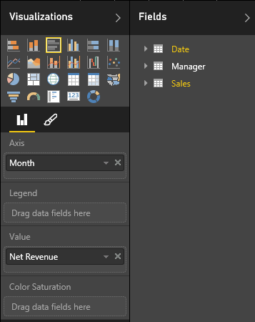
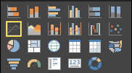
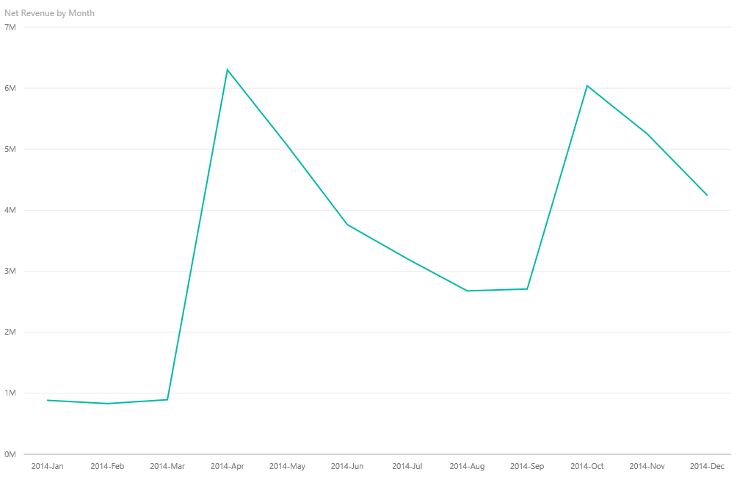
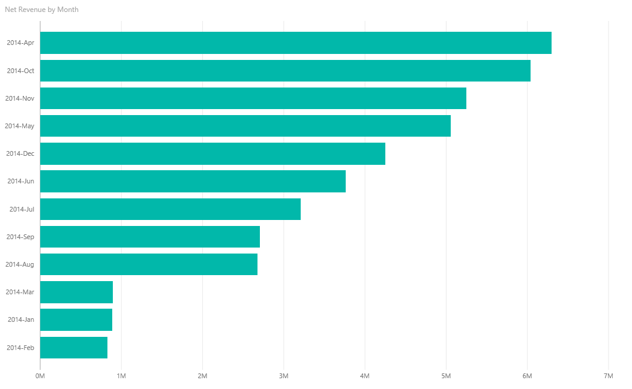
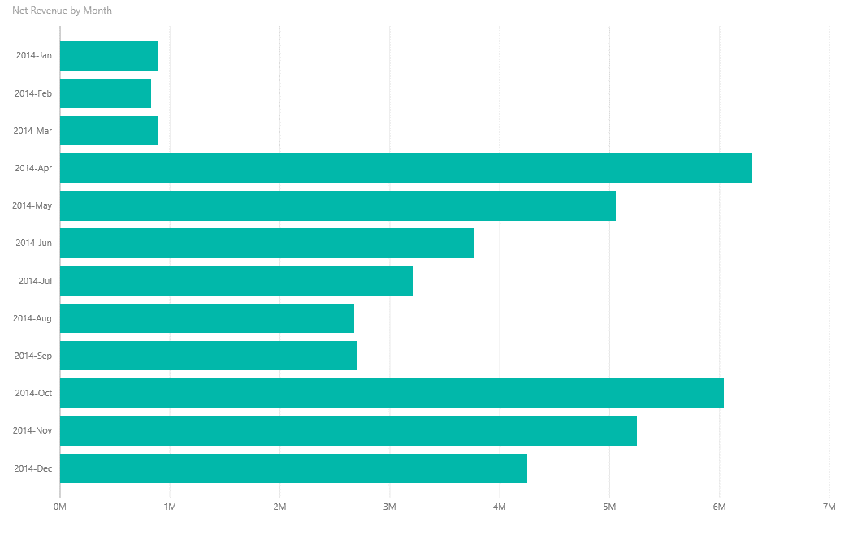

Exploring with Q&A
Example

Slide 18
Describing additional capabilities
Additional capabilities:
Pinning SQL Server Reporting Services reports (Preview)
Pinning Excel ranges
Pinning snapshots of Excel elements (Preview)

Slide 19
Describing additional capabilities
Pinning SQL Server Reporting Services reports (Preview)
Visuals from existing, on-premises Reporting Services reports, can be pinned to Power BI dashboards
To setup, use Reporting Services Configuration Manager to register the report server with Power BI
To pin visuals, use Report Manager to select a visual and to also configure the frequency of updates (hourly or daily)
Updates are achieved by using a Reporting Services subscription
Available in preview, since SQL Server 2016 CTP 3.0

Slide 20
Describing additional capabilities
Pinning Excel ranges
﻿Ranges can be pinned from Excel workbooks that have been saved in:
OneDrive for Business, or
Another group-shared document library
Ranges can contain data, charts, tables, PivotTables, PivotCharts, and other Excel parts
You can view—but not pin—tiles from workbooks that have been shared with you

Slide 21
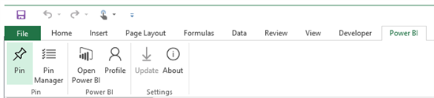
Describing additional capabilities
Pinning snapshots of Excel elements (Preview)
Install the Power BI Publisher for Excel add-in to share snapshots of Excel elements to online dashboards in seconds:
Elements include PivotTables, charts, and ranges
Requires Excel 2010 SP1, or later (32- or 64-bit)

Slide 22
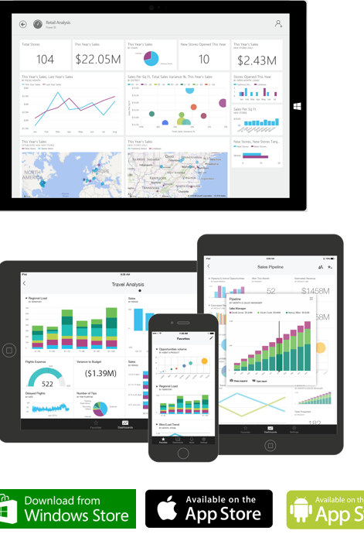
Mobile applications
Install native mobile applications to access dashboards, available for:
Windows
iOS (iPhone and iPad)
Android
Supported capabilities:
Set favorites for important visualizations
Zoom in and out of visualizations
Annotate visualizations and share snapshots with others
Configure alerts to receive notifications of critical business KPIs

Slide 23
Power BI REST API
Use the Power BI REST API to push data directly from an application into a Power BI dataset
Client application
Web application
Programmatically manage resources:
Datasets
Tables
Dashboards will update in real-time as data is added
No more waiting, or needing to press the Refresh button! ☺

Slide 24

Power BI REST API
Object model hierarchy
A Power BI tenant can have multiple datasets, which are identified by a GUID
A dataset can:
Be owned by a user or a group
Have multiple tables, which are referenced by name
A table has multiple rows
Power BI
Datasets
Tables
Rows

Slide 25
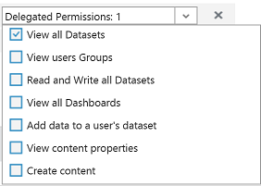
Power BI REST API
Authentication
An application must be registered, and is required to establish an identity for the application
Applications are identified by their Client ID
Permissions are delegated to the Power BI service
REST API calls are made on behalf of an authenticated user by passing a token in the “Authorization” header

Slide 26
Power BI REST API
Application registration
An application can be registered with
Power BI App Registration Tool at http://dev.powerbi.com/apps, or
Azure Management Portal
The Power BI App Registration Tool is the easiest option since there are just a few fields to fill in
If you want to make changes to you app, this can only be done through the Azure Management Portal

Slide 27
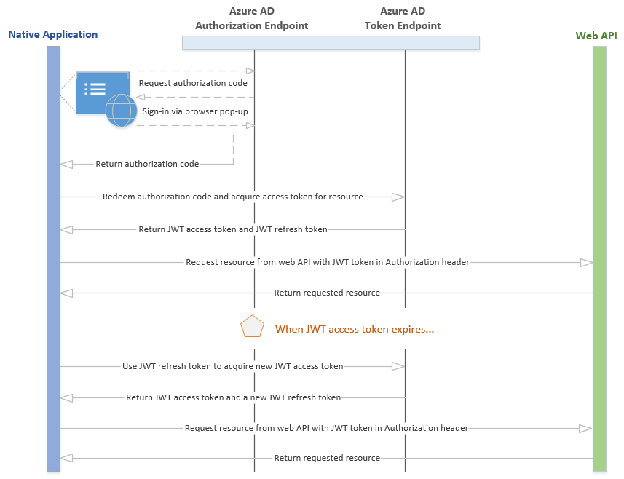
Power BI REST API
Authentication flow: Client application

Slide 28
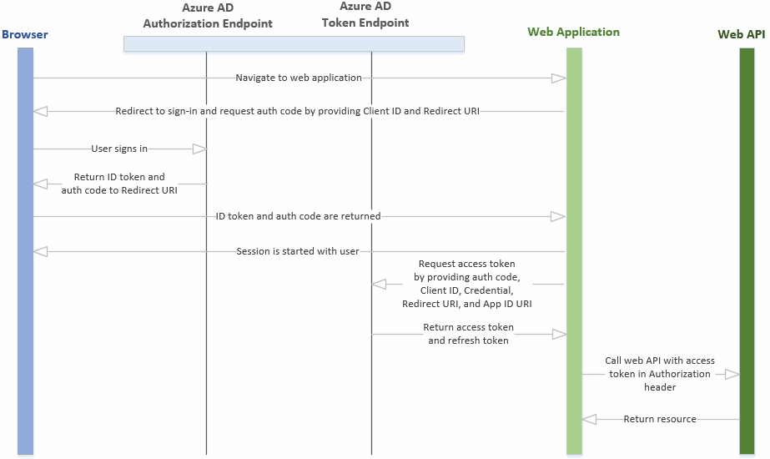
Power BI REST API
Authentication flow: Web application

Slide 29
Power BI REST API
Operations
Operation | Method
List all datasets | GET | Returns a JSON list of all dataset objects that includes a name and dataset ID
Create a dataset | POST | Creates a new dataset with the schema definition that is in the JSON body, and returns the dataset ID and the properties of the objects created
List all tables | GET | Returns a JSON list of tables for the specified dataset
Update an existing table schema | PUT
Add rows to a table in a dataset | POST
Clear the rows in a table | DELETE
List all groups | GET | Returns a JSON list of all the groups of which the user is a member
List all dashboards | GET | (In preview)
List all tiles | GET | (In preview) Returns a JSON list of tiles for the specified dashboard. Use this method to retrieve the embed URL.
List all reports | GET | (In preview) Use this method to retrieve the embed URL

Slide 30
Power BI REST API
Example: List all datasets
Request
GET https://api.powerbi.com/v1.0/myorg/datasets HTTP/1.1 Authorization: Bearer {AAD Token} Content-Type: application/json; charset=utf-8
Response
{ "datasets": [ { "id": "2C0CCF12-A369-4985-A643-0995C249D5B9", "name": "Music" }, { "id": "C446840B-94AD-4B23-8896-C276E69B8FAA", "name": "SalesMarketing" } ] }

Slide 31
Power BI REST API
Example: Add a row to a table in a dataset
Request
POST https://api.powerbi.com/v1.0/myorg/datasets/2C0CCF12-A369-4985-A643-0995C249D5B9 /Tables/Product/Rows HTTP/1.1 Authorization: Bearer {AAD Token} Content-Type: application/json; charset=utf-8 { "rows": [ { "ProductID":1, "Name":"Adjustable Race", "Category":"Components", "IsCompete":true, "ManufacturedOn":"07/30/2014" } ] }

Slide 32
Power BI REST API
Restrictions
Maximum rows per single push: 10K
Note that ingestion rates are restricted by license:
Power BI license: 10K rows/hour
Power BI Pro license : 1M rows/hour
Maximum rows per table: 5M
A dataset is defined with a retention policy:
none: Rows will be collected to the limit
basicFIFO: Will keep up to 200K rows, and remove the oldest rows as new rows are added
Maximum pending requests: 5

Slide 33
Delivering a real-time Power BI dashboard with the REST API
05A

Slide 34
Integrate Power BI
Integrate a Power BI tile or report into an app with an IFrame HTML element
For example, create a custom mobile app to display real-time Power BI tiles and reports on the user’s mobile device
Use the REST API to retrieve the embed URL
Once embedded, a click event handler can be added to enable navigation to the dashboard
This capability is presently in preview

Slide 35
Custom visuals
Developers can develop custom visuals for use in Power BI solutions
To help developers get started, Microsoft has published the code for all of their visualizations
This is all available as an open source project on GitHub
The project contains over 20 visualization types, the framework to run them, and the testing infrastructure that enables you to build high quality visualizations
The framework provides all the interfaces required to integrate fully with Power BI's selection, filtering, and other UI experiences
Developers are encouraged to submit their custom visuals to the Power BI Visuals Gallery for sharing with the Power BI community

Slide 36
Power BI licensing
Feature differences
In short, the differences between the two licenses:
Feature | Power BI (Free) | Power BI Pro
Data capacity limit | 1 GB/user | 10 GB/user
Consume content that is scheduled to refresh | Daily | Up to 8 times per day
Data streaming rate | 10K rows/hour | 1M rows/hour
Consume live data sources will full interactivity | No | Yes
Access on-premises data with gateways | No | Yes
All other collaboration features | No | Yes
Non-”Power BI Pro” users can share dashboards. However, a Power BI Pro license is required to interact with, or consume, content using features that are only available to users with a Power BI Pro license.

Slide 37

What if your app could put the power of analytics everywhere decisions are made?
Modern apps with data visualizations built-in have the power to inform decisions in context—
for any user on any device

Slide 38

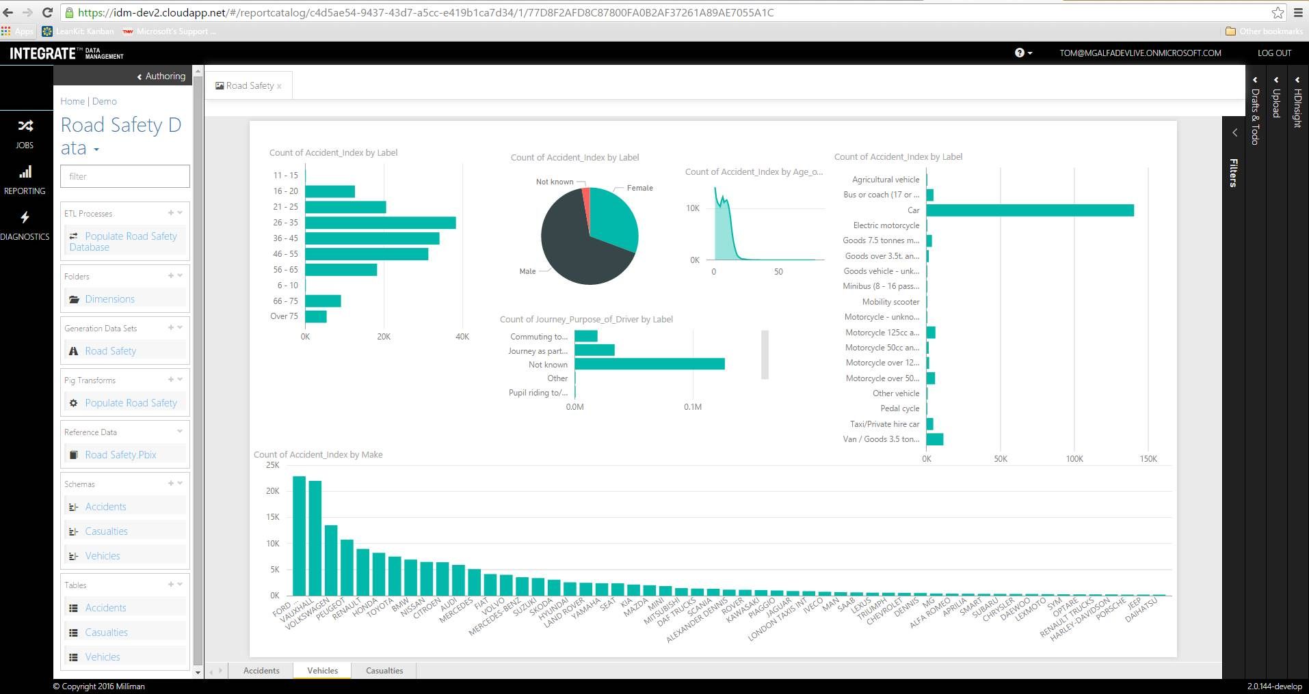
Demo
Embedded reports

Slide 39

Power BI Embedded
Virtual Machines
Web + Mobile
Data + Storage
Data + Analytics
Internet of Things
Networking
Media + CDN
Hybrid Integration
Security + Identity
Developer Services
Management
Intelligence
Containers
Power BI Embedded
Cognitive Services APIs
Data Catalog
HDInsight
Data Lake Analytics
Machine Learning
Data Factory
Event Hub
Stream Analytics job
Cloudera Enterprise Data Hub
Hortonworks Sandbox with HDP 2.4
Your app
PREVIEW
A core component for Azure analytics services

Slide 40
Manage in a familiar environment—Azure
Azure Portal
Azure SQL Database
Power BI Workspace
Power BI report
Azure SQL Data Warehouse
Your app
Manually or programmatically provision workspaces
Create datasets and reports
Embed reports in your app
Control refresh behavior and credentials
Power BI Desktop

Slide 41

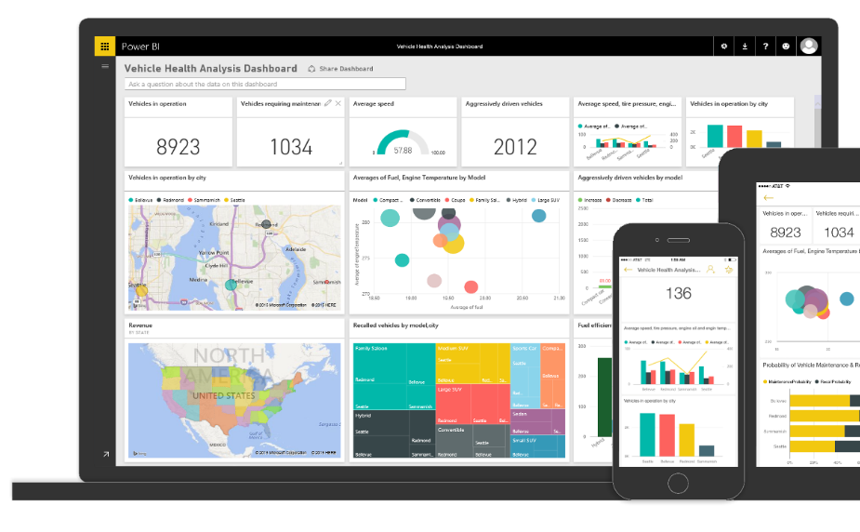

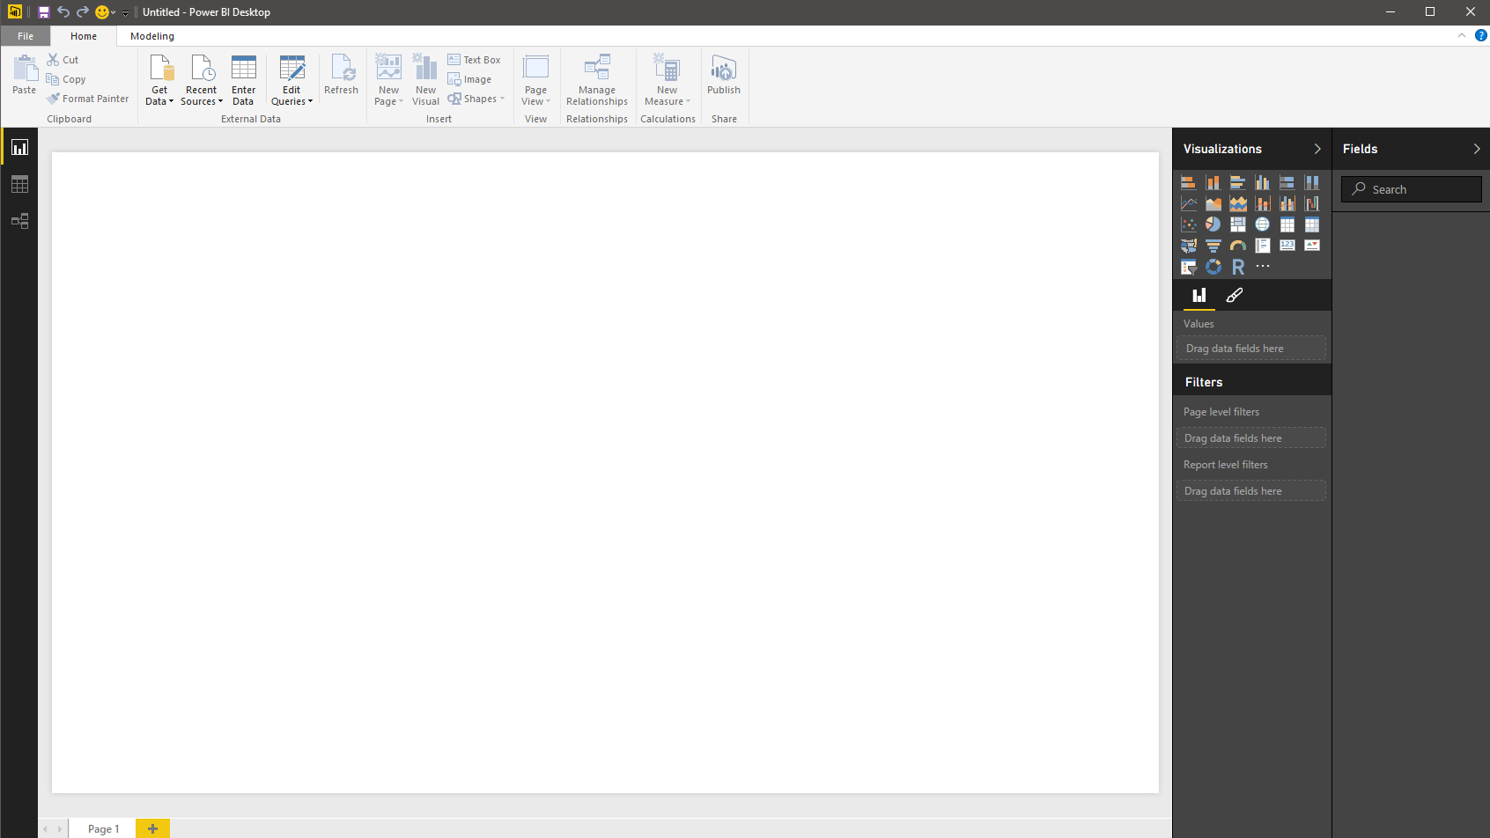
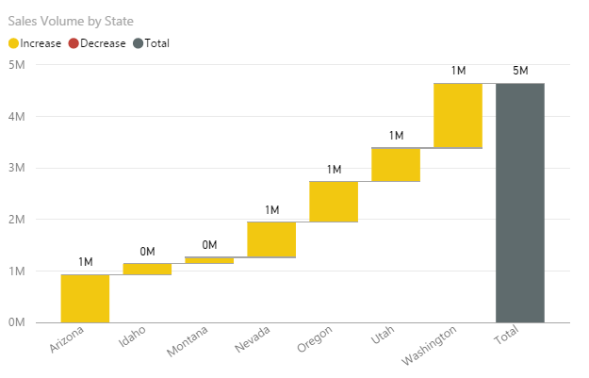
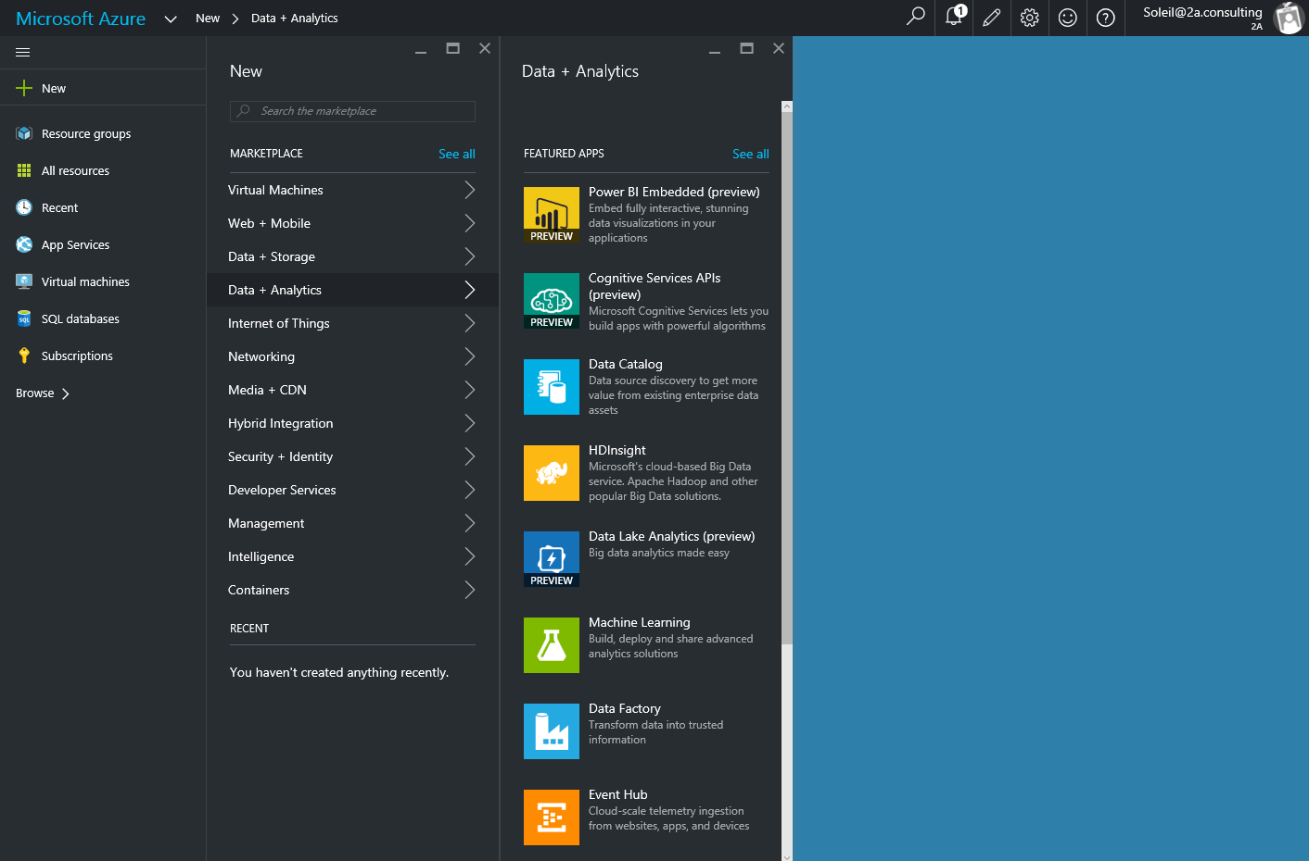
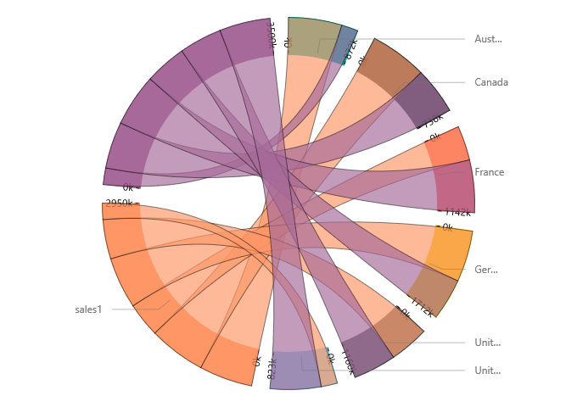
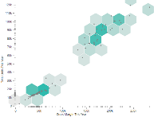
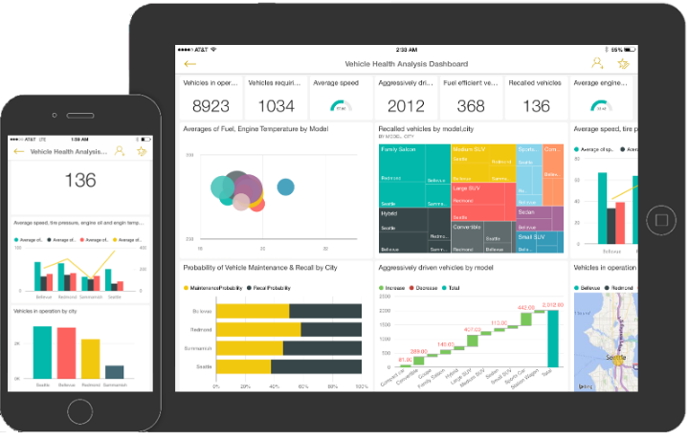
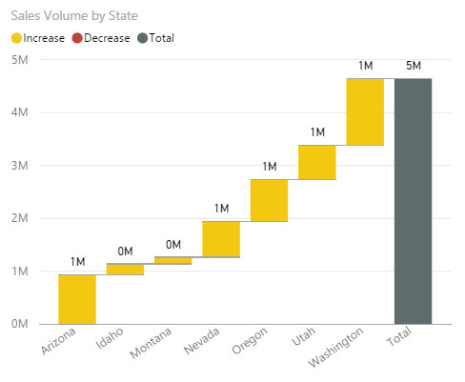
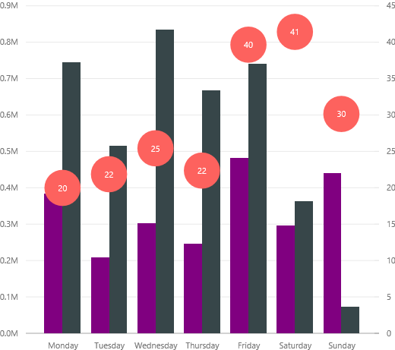
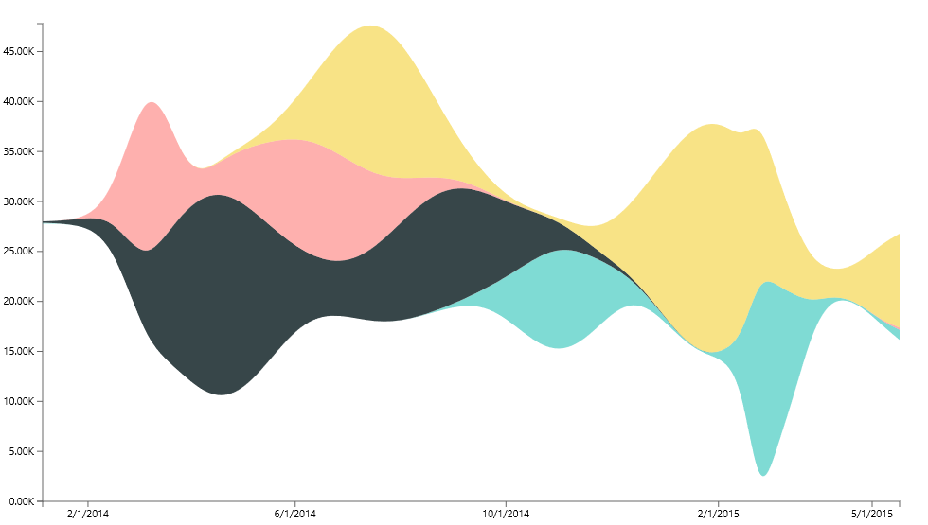
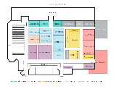
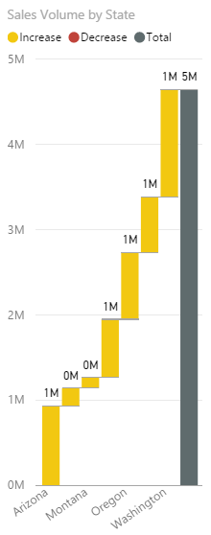
You have the app. You have the data. Bring data to life inside your app with Power BI Embedded
Create compelling interactive reports
Embed easily for faster time to value
Deploy quickly and manage with ease

Slide 42

Create compelling interactive reports that are always up to date
Author interactive reports without writing any code
Choose modern visualizations out-of-the-box or customize without building them from scratch
Visualize any data from a variety of cloud sources
Keep your data always-up-to-date with DirectQuery
Create
Embed
Deploy

Slide 43
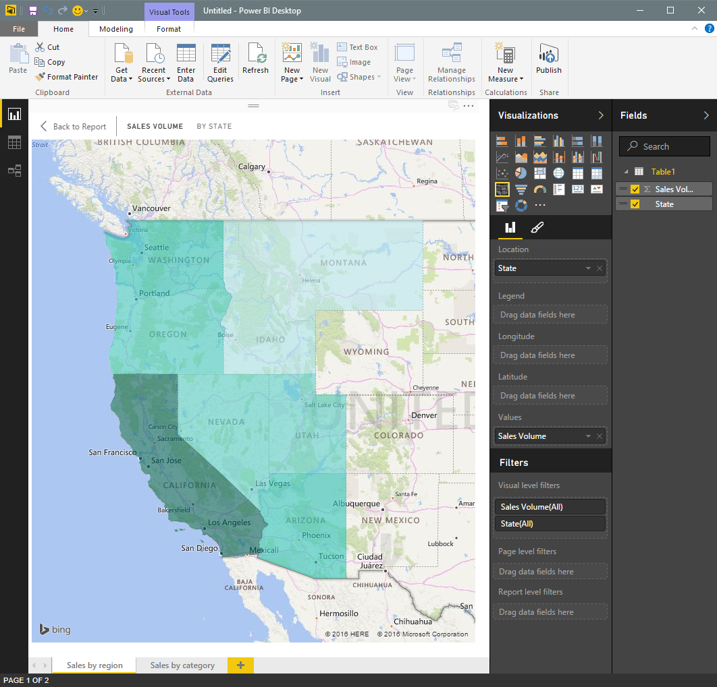
Easily author interactive reports for free in Power BI Desktop
Shape data into the format and structure you need
Produce rich data models using formulas and relationships
Explore data through a freeform, drag-and-drop canvas
Publish interactive data visualizations to your app
Create
Embed
Deploy

Slide 44
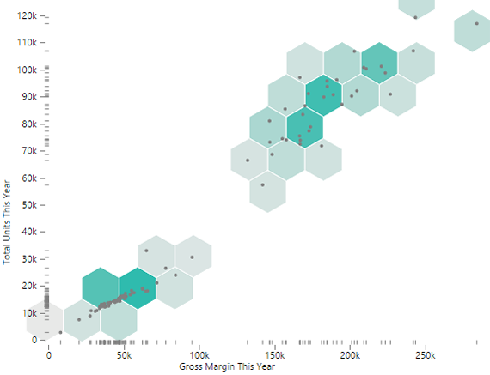
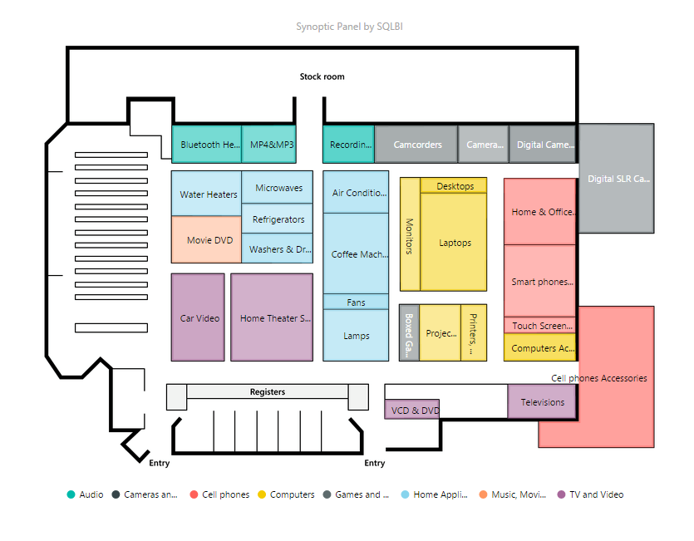
Get started quickly with Microsoft’s open-sourced, production-quality visualization code
Leverage the visualization framework, test suite and tooling to build the right custom visuals for your app
Create
Embed
Deploy

Slide 45

Demo
Visuals

Slide 46
Keep visuals up to date without refreshing data using DirectQuery
Azure SQL Database
Connect directly to the source without moving your data
Build visualizations over very large datasets
Azure SQL Data Warehouse
Power BI report
Your app
Create
Embed
Deploy

Slide 47

Embed visuals easily—for any device and faster time-to-value
Easily embed interactive visuals in your app using REST APIs and the Power BI SDK
Ensure consistent high-fidelity data experiences across any device
Provide friction-free authentication and authorization experiences
Realize faster time-to-value without redesigning your app
Create
Embed
Deploy

Slide 48
Power BI Embedded API surface
Your app
Power BI APIs
Discovery: Enumerate datasets and reports
Content Creation: Provision datasets and reports
Embed: Embed reports
Utility: Set connection strings and credentials
Programmatic
REST APIs
Azure Resource Manager API
Azure APIs for automation
Microsoft Azure
Power BI Embedded
Platform
Provision workspace collections
De-provision workspace collections
Manage API keys
Azure SQL Database
Azure SQL Data Warehouse
Data
Create
Embed
Deploy

Slide 49




Ensure consistent, high-fidelity data visualization experiences across any device
Built-in, responsive design adjusts content for different devices and orientations
Visualizations are built on open technologies like D3 and WebGL
Rendered in HTML5
Create
Embed
Deploy

Slide 50
Provide seamless authentication experiences
Application
Power BI
Users
Workspace
Auth. providers
Token
+ Claim: Can view Report 1
+ Expiration: 5 minutes
Report 1
Permissions
Report 2
Sign token
API keys
API keys
Copy API keys to your application
Create
Embed
Deploy

Slide 51
Provide seamless authentication experiences
Application
Power BI
User requests to view Report 1
Users
Workspace
Auth. providers
Token
+ Claim: Can view Report 1
+ Expiration: 5 minutes
Report 1
Permissions
Report 2
Validate token
API keys
API keys
Create
Embed
Deploy

Slide 52
Provide seamless authentication experiences
Application
Power BI
Users
Workspace
Auth. providers
Report 1
Report 1
Permissions
Report 2
API keys
API keys
Create
Embed
Deploy

Slide 53

Deploy quickly at cloud scale while managing costs and resources
Automate deployment via Power BI and Azure Resource Management APIs
Automatically scale as your app grows
Pay as you go with consumption-based pricing
Create
Embed
Deploy

Slide 54
Manage in a familiar environment—Azure
1,N
Microsoft Azure subscription
Developer
1,N
Workspace collection
Name
Admin Users
Endpoints
Keys
Gateways
Credentials
Geo Location
Tags
Azure SQL Database
Manually or programmatically provision workspaces
Create datasets and reports
Embed reports in your app
Control refresh behavior and credentials
Azure SQL Data Warehouse
1,N
Workspace
Name
Reports
Datasets
Tags
Embed
Your app
End users
Create
Embed
Deploy

Slide 55
Control costs with pay-as-you-go consumption-based pricing
Price per report session, per month in effect September 1st, 2016
0-100 sessions | Free
100+ sessions | $0.05/report session
What is one report session?
Every time a Power BI report is loaded inside your app. A session is valid for 60 minutes .
Author interactive reports in Power BI Desktop for free
Priced per report session
Single report can have multiple pages and multiple charts
ISV applications and Enterprise external facing apps only
Query
Your data
Your users
Cache

Slide 56
ISV Opportunities
As an ISV choose how you monetize Power BI Embedded
Differentiate your data experiences i.e. Openhour (Video)
Offer premium SKUs with built-in analytics i.e. Nintex (Video)
Provide additional services i.e. Act-On
All of the above

Slide 57
Get started for free, today
https://azure.microsoft.com/services/power-bi-embedded/
Stay up-to-date with Power BI developer news
dev.powerbi.com

Slide 58
Choose the right Power BI service
Is the app exclusively used by internal employees?
Do users need to be authenticated?
No
No
Yes
Yes
Use PowerBI.com REST APIs
Use Power BI Embedded
Use Power BI publish to web
Authentication
Via PowerBI.com Azure Active Directory
Via application, using Power BI app tokens
N/A
User licensing
Users PowerBI.com subscription
Consumption based, via Azure No end-user license required
No end-user license required
Report authoring
Power BI Desktop and Power BI.com subscription
Power BI Desktop Azure subscription
PowerBI.com subscription and/or Power BI Desktop

Slide 59
Developer resources
Home page
http://azure.com/powerbiembedded
Developer center
http://dev.powerbi.com
Developer blog
http://blogs.msdn.com/powerbidev
Samples
http://github.com/PowerBI
Open source visuals
http://github.com/Microsoft/PowerBI-visuals
Visuals gallery
http://visuals.powerbi.com
Ask us questions
http://stackoverflow.com/questions/tagged/powerbi

Slide 60



Transform data into intelligent action
Information Management
Big Data Stores
Machine Learning and Analytics
Intelligence
People
Data Sources
Data Factory
Data Lake Store
Machine Learning
Cognitive Services
Data Catalog
SQL Data
Warehouse
Data Lake Analytics
Bot Framework
Web
Apps
HDInsight
(Hadoop and Spark)
Mobile
Event Hubs
Cortana
Apps
Bots
Sensors and devices
Stream Analytics
Dashboards & Visualizations
Automated Systems
Power BI
Data
Data
Intelligence
Action

Slide 61
Final Demo

Slide 62
Q&A

Slide 63

© 2016 Microsoft Corporation. All rights reserved.

Slide 64
Appendix

